Slide 1
RiskLens
Market Risk VaR & CVaR Framework
My VaR model passed the Kupiec test.
Then it failed everything else.
$217K
41
−$2.5M
VaR 99%
(Historical)
VaR Breaches
vs 25.2 Expected
GFC Hypothetical
Instant Loss
Kush Bhanushali · MS Quantitative Finance · Python · pandas · NumPy · SciPy · Plotly · FRED API · Basel III / FRTB

Slide 2
What I Built
End-to-end market risk framework · Python · Basel III / FRTB · 2015–2024
01
02
03
04
05
Data
Pipeline
VaR
Models
CVaR
/ ES
Back-
testing
Stress
Testing
▶
▶
▶
▶
· 5 equities — Stooq.com
· Historical Simulation
· Expected Shortfall
· Kupiec POF Test
· Q4 2018 Selloff
· 3 FX pairs — FRED API
· Parametric (Normal)
· FRTB 97.5% level
· Christoffersen CC Test
· COVID Crash 2020
· 2,516 trading days
· Monte Carlo 10K sims
· Component CVaR by asset
· Basel Traffic Light
· Rate Hike Shock 2022
· Log returns + dollar P&L
· 252-day rolling window
· Rolling 1-year CVaR
· Breach clustering analysis
· 4 hypothetical shocks
TECH STACK
DATA SOURCES
Python
pandas
NumPy
SciPy
Plotly
FRED API
📈 Stooq.com NVDA · JPM · XOM · JNJ · SPY (daily OHLCV)
Basel III
FRTB
Kupiec
Christoffersen
Monte Carlo
Stooq.com
🏦 FRED API EUR/USD · GBP/USD · JPY/USD (daily FX rates)
📐 Portfolio 60% equities · 40% FX · $10M notional · log returns

Slide 3
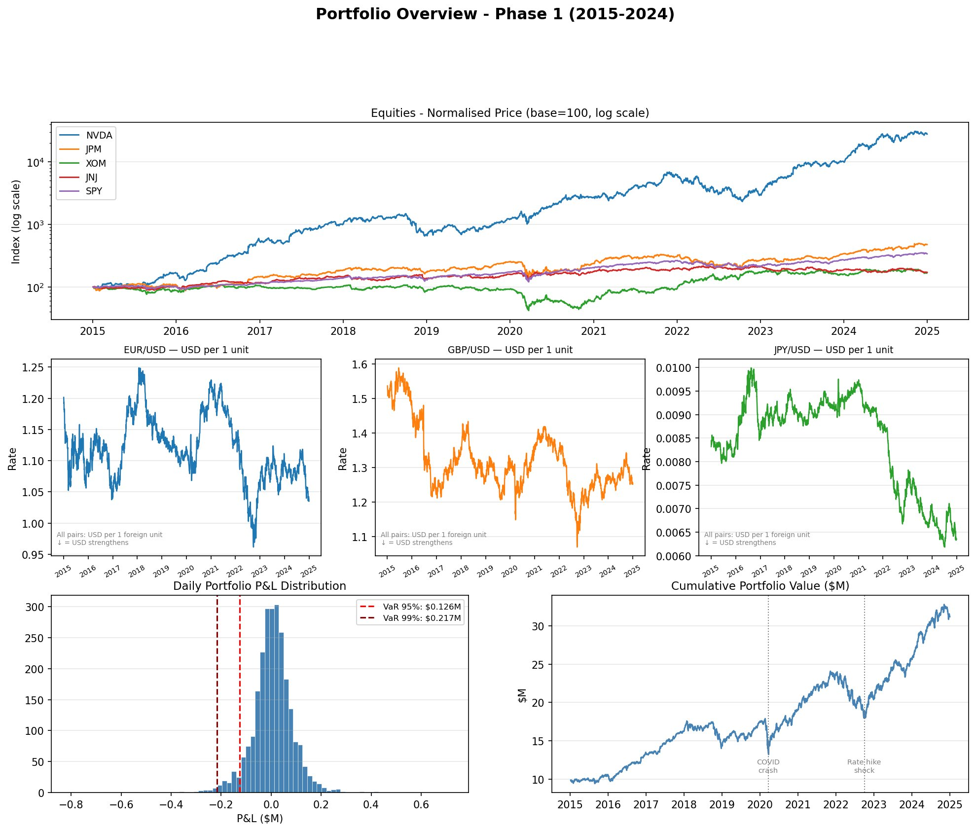
PHASE 1
Portfolio Overview — 10 Years, 8 Assets, $10M
KEY METRICS
2,516
8
Trading Days
Assets
$10M
150×+
Notional
NVDA Return
Portfolio P&L Highlights
VaR 95%: $126K daily loss threshold VaR 99%: $217K — fat left tail confirmed Portfolio: $10M → $32M over 10 years
Data: Stooq.com (equities) · FRED API (FX) · 60% equities / 40% FX by notional weight

Slide 4
CONCEPT
Value at Risk (VaR) — the daily loss you won't exceed 99% of the time
?
What is Value at Risk (VaR)?
!
What I Found in This Portfolio
The question it answers
Historical VaR 99% = $217K
If markets move against me tomorrow, what is the worst loss I should expect on a normal day?
On any given day, there is a 1% chance the portfolio loses more than $217K. This is the most conservative of the three methods.
How it works
13% fat-tail premium
Rank all historical daily P&L from worst to best. VaR 99% is the loss at the 1st percentile — only 1% of days were worse.
Historical VaR is $217K vs Parametric's $199K. The gap exists because real returns have heavier tails than a normal distribution.
Three methods
VaR 95% = $126K
Historical (use real past data), Parametric (assume normal distribution), Monte Carlo (simulate thousands of random scenarios).
At the 95% confidence level, losses exceed $126K only 1 day in 20. Used as a lower-stakes daily risk check.
The regulatory context
Q-Q plot confirms non-normality
Banks must calculate VaR daily under Basel III. If actual losses exceed VaR too often, regulators impose higher capital charges.
The quantile-quantile plot shows returns deviate significantly from the normal fit at the extremes — fat tails are real.
RiskLens · Kush Bhanushali · MS Quantitative Finance · Basel III / FRTB

Slide 5
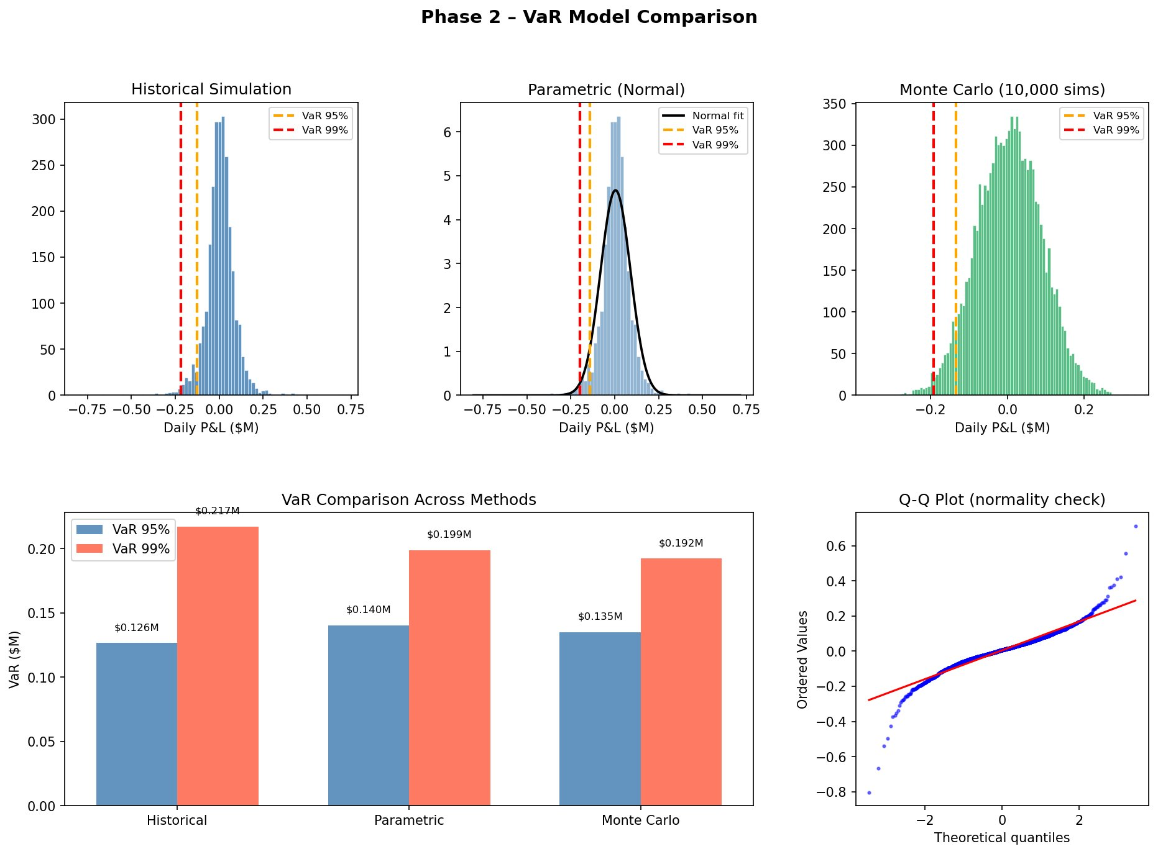
PHASE 2
VaR Model Comparison — Three Methods, One Portfolio
Historical Non-parametric
Parametric Normal dist.
Monte Carlo 10,000 sims
95%: $126K 99%: $217K
95%: $140K 99%: $199K
95%: $135K 99%: $192K
Highest 99% — fat tails captured
Underestimates tail by 8.3%
Most conservative at 95%
Q-Q plot confirms fat tails — Historical VaR 99% = $217K is 13% above Parametric. Normal distribution materially understates tail risk.

Slide 6
CONCEPT
CVaR / Expected Shortfall — the average loss in the worst 2.5% of scenarios
?
What is CVaR / Expected Shortfall?
!
What I Found in This Portfolio
The problem with VaR
CVaR is 1.35–1.44× VaR
VaR tells you the threshold — 'you won't lose more than $217K on 99% of days.' But it says nothing about how bad the worst 1% of days actually are.
At every confidence level, ES exceeds VaR by 35–44%. FRTB's switch from VaR 99% to ES 97.5% captures $59K more potential loss.
What CVaR adds
NVDA = 39.9% of tail risk
CVaR (also called Expected Shortfall) averages all the losses beyond the VaR threshold. It answers: 'when things go really wrong, how bad does it get?'
At only 15% portfolio weight, NVDA drives 39.9% of Expected Shortfall. A single AI regulation event could breach risk limits.
Why regulators prefer it
JPY/USD is a genuine hedge
Basel FRTB (2019) replaced VaR 99% with ES 97.5% as the standard capital measure. ES is more sensitive to tail severity and penalises extreme losses properly.
Component CVaR for JPY/USD = −0.8%. The yen position actively reduces tail risk — it's not just uncorrelated, it's protective.
Component CVaR
COVID spike: $0.50M ES
You can decompose ES by asset to see which position drives tail risk. This reveals hidden concentrations that portfolio-level VaR obscures.
Rolling 1-year CVaR spiked from $0.18M to $0.50M in March 2020 — a 3× jump in just weeks, showing tail risk is time-varying.
RiskLens · Kush Bhanushali · MS Quantitative Finance · Basel III / FRTB

Slide 7
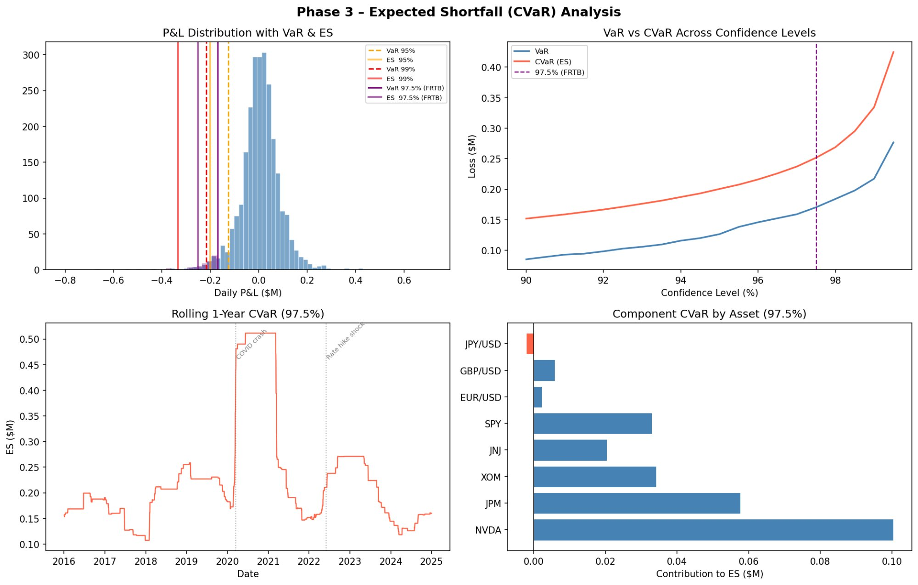
PHASE 3
Expected Shortfall (CVaR) — What VaR Doesn't Tell You
Why Basel FRTB Switched to ES
VaR only tells you the loss threshold.
ES averages ALL losses beyond it.
FRTB mandates ES at 97.5%, replacing VaR 99%.
Confidence | VaR | CVaR / ES | ES/VaR
95% | $127K | $183K | 1.44×
97.5% (FRTB) | $162K | $221K | 1.36×
99% | $217K | $298K | 1.37×
⚠ NVDA (15% weight) = 39.9% of tail risk
JPY/USD (10% weight) = −0.8% (genuine hedge)
Rolling 1-year CVaR spiked from $0.18M → $0.50M during COVID (2020) — 3× the normal baseline. Tail risk is not stable over time.

Slide 8
CONCEPT
Backtesting — checking whether your risk model predicted reality
?
What is Backtesting?
!
What I Found in This Portfolio
The basic idea
Kupiec Test: PASS (VaR 95%)
After building a VaR model, you test it: compare what the model predicted each day against what actually happened. Did losses exceed VaR more or less than expected?
At the 95% confidence level, the model performs statistically well — breach frequency is within expected bounds (p = 0.87).
Kupiec POF Test
Christoffersen Test: FAIL
Tests whether the number of VaR breaches is statistically reasonable. At VaR 99%, you expect 1% of days to breach — too many or too few both signal model failure.
Clustering ratio = 2.45×. Breaches are not independent — they arrive in groups during stress periods, not randomly throughout the year.
Christoffersen CC Test
VaR 99% Overall: FAIL
Goes further: checks whether breaches cluster in time. A good model should have independent breaches. Clustered breaches mean the model is blind to volatility regimes.
41 actual breaches vs 25.2 expected. The model significantly underestimates tail risk at the 99% level over the full 9-year period.
Basel Traffic Light
Basel RED zone — 4.0× multiplier
Regulators categorise models: Green (0–4 breaches/year, 3× capital multiplier), Yellow (5–9), Red (10+, 4× multiplier). Red zone means higher capital requirements.
10+ annual breaches puts the portfolio in Basel's Red zone. This would trigger a 4× capital multiplier on market risk RWA in a real bank.
RiskLens · Kush Bhanushali · MS Quantitative Finance · Basel III / FRTB

Slide 9
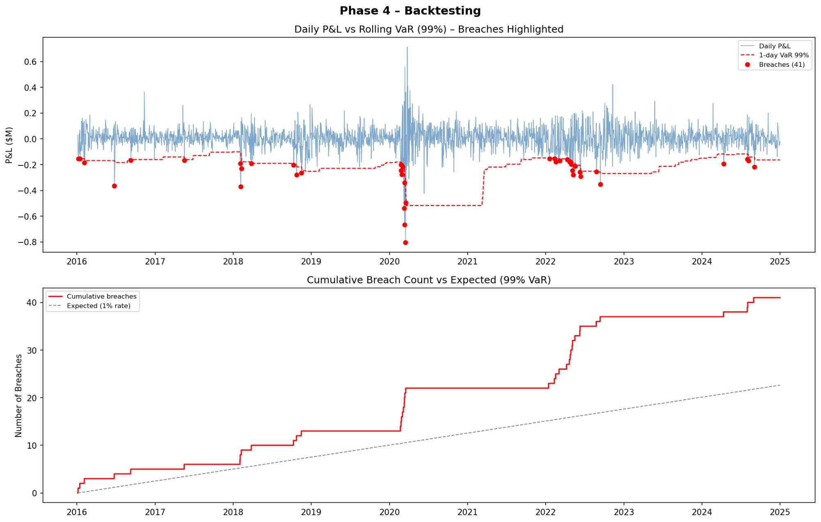
PHASE 4
Backtesting — The Model Fails When It Matters Most
Kupiec POF
✓ PASS
VaR 95%: p = 0.87
Christoffersen CC
✗ FAIL
Clustering ratio = 2.45×
VaR 99% Overall
✗ FAIL
41 actual vs 25.2 expected
🔴 Basel RED Zone — 4.0× Capital Multiplier
Breaches: 10+ → Regulatory penalty triggered
COVID cluster: 8 breaches in a single month (Feb–Mar 2020). The model cannot distinguish calm from stressed regimes — Christoffersen test FAIL confirms regime-blindness.

Slide 10
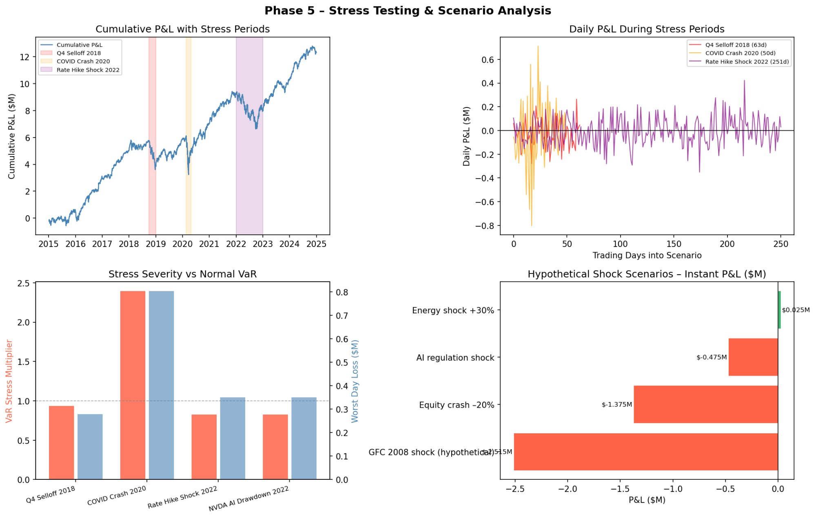
PHASE 5
Stress Testing — What Happens When Models Break Down
SHOCK SCENARIOS
GFC 2008 (Hypothetical)
−$2.515M 25% of notional
Equity Crash −20%
−$1.375M 13.75% of notional
AI Regulation Shock
−$0.475M NVDA single event
Energy Shock +30%
+$0.025M XOM hedge benefit
COVID stress multiplier = 2.4× VaR. Rate Hike Shock 2022 = 2.4× VaR. Historical VaR is not stress VaR — they measure fundamentally different risk regimes.

Slide 11
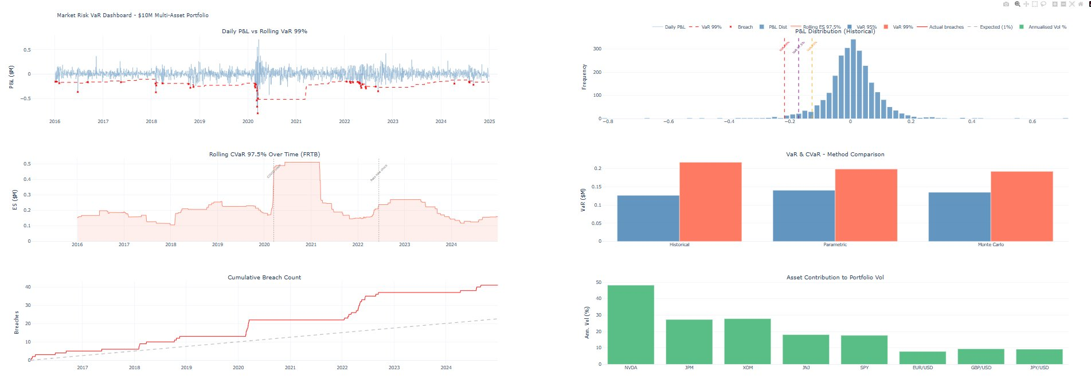
Interactive Dashboard
Live Plotly HTML · 6 charts · Full code on GitHub
kush2071.github.io/RiskLens/var_dashboard.html
WHAT'S INSIDE
📊
6 Interactive Charts
All Plotly — zoom, hover tooltips, click legends to toggle series
🔴
VaR Breach Markers
Every exceedance highlighted in real-time with date + magnitude
📅
Event Annotations
COVID crash & Rate Hike shock marked on time-series charts
⚖️
Method Comparison
Side-by-side Historical vs Parametric vs Monte Carlo
🌊
Rolling Risk
252-day rolling VaR and 1-year rolling CVaR over full period
🔗
Single HTML File
No server needed — open in any browser, share by email or URL
🔗 Live Dashboard: kush2071.github.io/RiskLens/var_dashboard.html | 📂 Full Code: github.com/Kush2071/RiskLens

Slide 12
RiskLens
6 Findings from a Full Basel III / FRTB Risk Framework
01
Fat Tails Are Real
02
ES Captures More Risk
Historical VaR 99% = $217K — 13% above Parametric. Normal distribution silently understates risk.
CVaR is 1.35–1.44× VaR. FRTB's switch to ES at 97.5% captures $62K more than VaR 99% equivalent.
03
Model Fails Under Stress
04
NVDA Concentration Risk
Basel RED zone: 41 breaches vs 25.2 expected. Christoffersen test confirms volatility clustering blindspot.
39.9% of tail risk from one 15%-weight position. AI concentration needs position limits or tail hedge.
05
COVID Stress = 2.4× VaR
06
FX Diversification Works
Pandemic drawdowns far exceed normal VaR. GFC hypothetical = −$2.515M instant loss (25% of notional).
JPY/USD CVaR = −0.8% — a genuine hedge, not just noise. FX allocation dampens equity tail risk by ~8%.
🔗 Live Dashboard: kush2071.github.io/RiskLens/var_dashboard.html | 📂 Full Code: github.com/Kush2071/RiskLens | Built with: Python · pandas · NumPy · SciPy · Plotly · FRED API

